Slide 1

Bioinformatics Algorithms
Prof. Beccuti
Explained by Bob the Bot

Slide 2

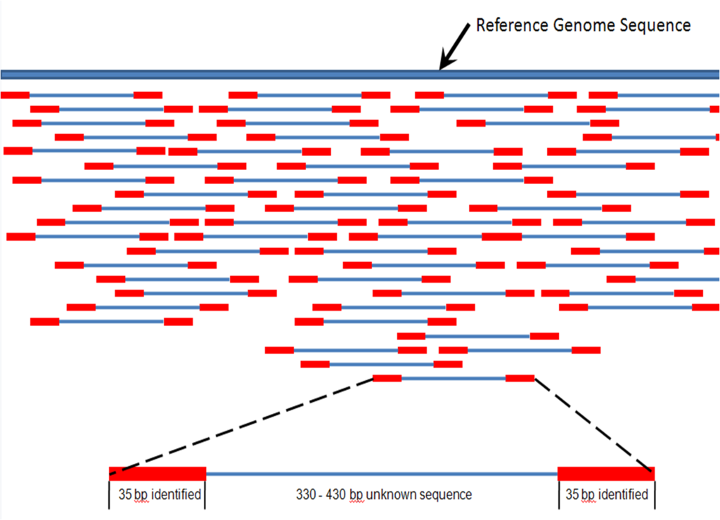
ALIGNMENT of DNA sequences
Why do we need to align DNA sequences?
NGS produces a lot of small reads, and the first analysis step is to align these sequences either together or to a reference genome. This alignment problem is shared among different biological research fields, such as Genetic disease research, construction of phylogenetic trees, comparing different sequences and almost all -seq techniques (like ChiP-seq).

Slide 3

This is our question:
I have two sequences: what is the best alignment that I can get?
This problem is more complex when we consider that gaps can be opened in the sequences to better align them, as insertions and deletions exist in biology.
For example, how can we align these two sequences?
ATGCATGC
TGCATGCC

Slide 4
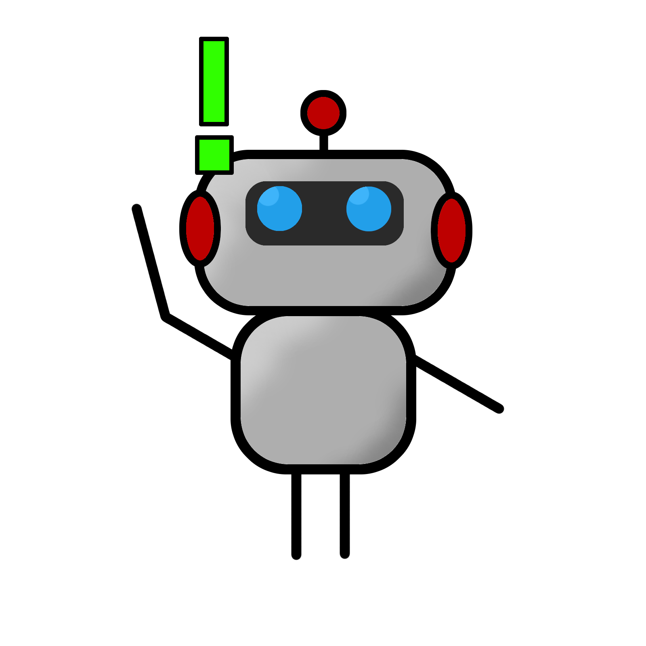
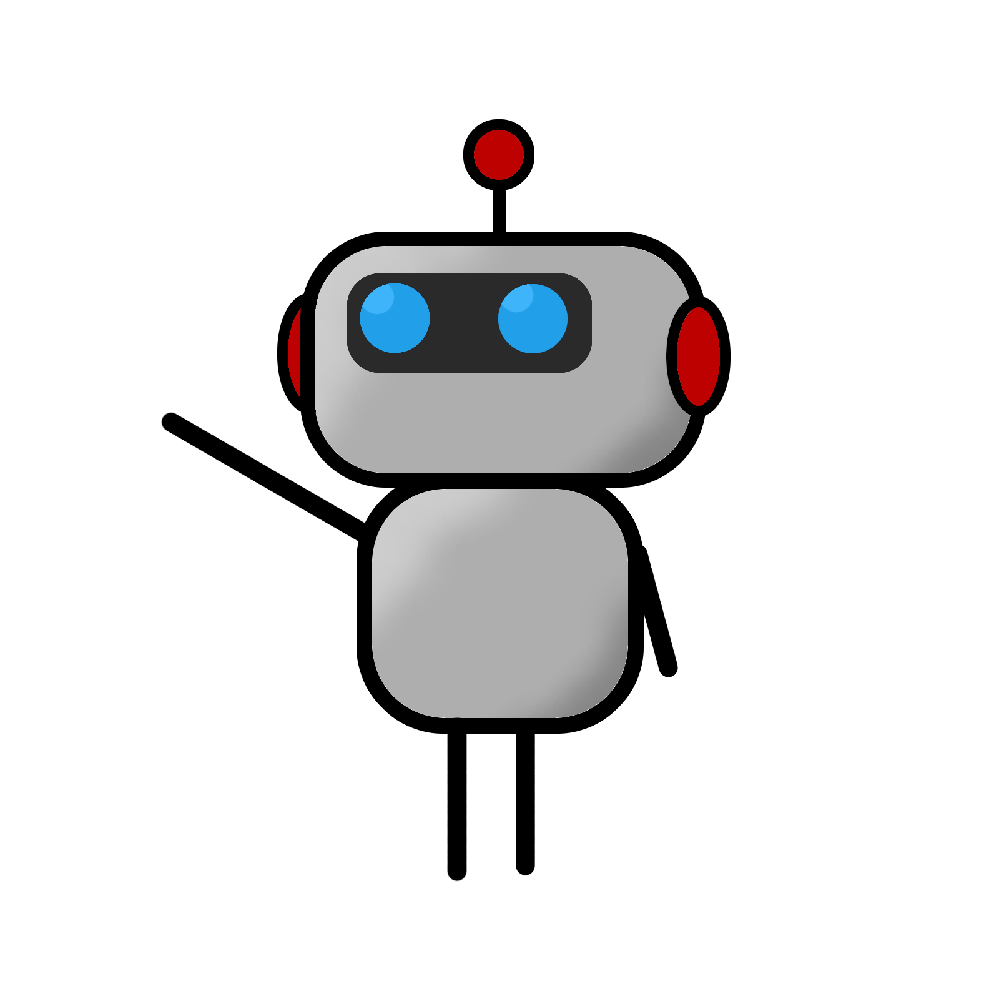
Well, this is an alignment, isn’t it? How can we check how good it is?
We can calculate the Hamming Distance between these two reads. The Hamming distance is defined as the number of nucleotides that do not match. So, a good alignment will result in a smaller Hamming Distance.
ATGCATGC
TGCATGCC
ATGCATGC
XXXXXXX-
TGCATGCC
Considering this alignment…
… the Hamming Distance is 7, which is very near our maximum of 8 (the length of the string).

Slide 5
Wait! If we just slide the bottom sequence over one position, we get...
ATGCATGC-
X-------X
-TGCATGCC
The Hamming Distance is reduced to 2! This is how important introducing gaps, and properly sliding the two sequences along themselves is during alignment.

Slide 6
When to add a gap? When to remove one? As we can see, the alignment task is very complex. We should try to simplify it, translating this problem into a game!
We can do two actions:
Remove a symbol from each sequence.
We receive 1 point if the symbols match, otherwise, we get 0 points.
Remove a symbol from one of the two sequences.
We receive 0 points doing this action.

Slide 7
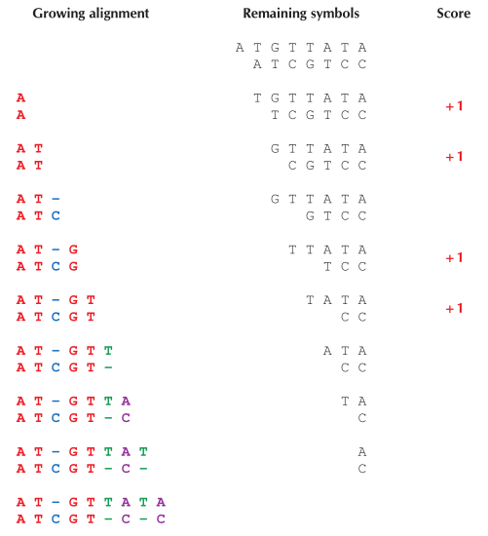

Let’s play! Using these two sequences, we can get a maximum score of . . .
Four!
Note that four is the best possible score we can get, but we can get it through different alignments.
Remove two symbols
Remove two symbols
Remove one symbol
Remove two symbols
For example, at this step we could have added a space, but our score wouldn’t have changed. The new alignment would be different, but its score would always be 4.
Remove two symbols
Remove one symbol
Remove two symbols
Remove one symbol
Have you noticed that our score is the length of the two aligned strings minus the Hamming distance?
Remove two symbols

Slide 8
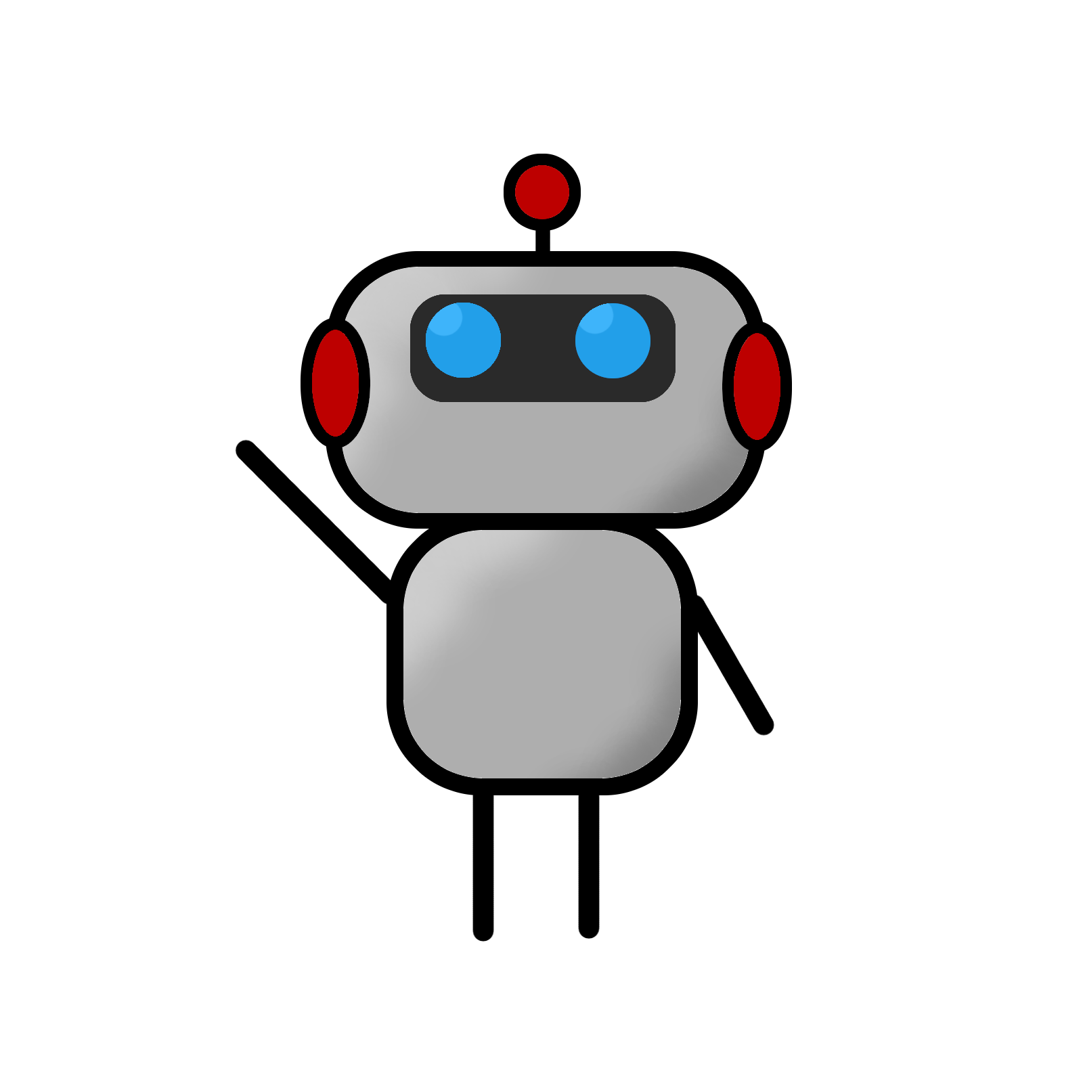
How can we teach a computer to play this game, and always do the best possible set of moves?
We have a computational problem:
Best Alignment Problem
Find the alignment that reduces the hamming distance (or some arbitrary parameter) between two strings to a minimum.
Input: two strings
Output: The best alignment of the two strings.
Computational problems are defined in this way.

Slide 9
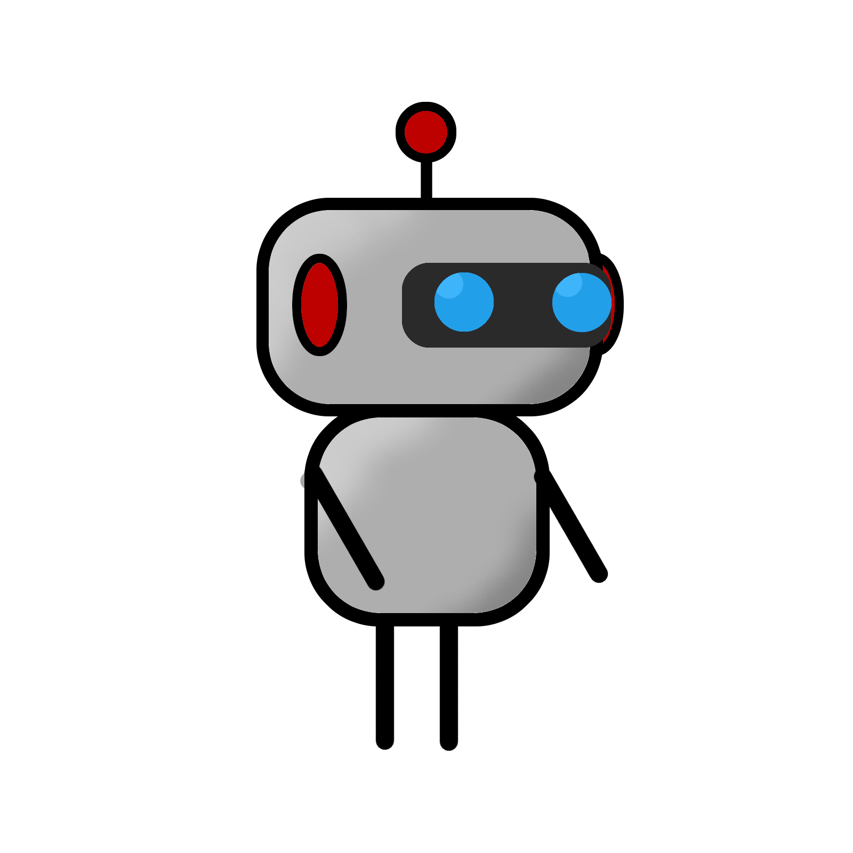
To be honest, I have no idea even how to begin. Do we just calculate the Hamming Distance of all possible alignments and take the lowest score?
For a few bases this might work, but for millions of reads to be aligned on a billion-base long genome, this would take an enormous amount of time!
Consider also that we have many copies of the genome to align, so we also have to take into account overlapping!
This is too much! I’ll go take a walk. . .

Slide 10
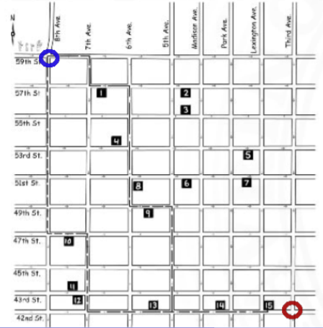
The MANHATTAN TOURIST problem
Mhmm. I want to take a stroll through the city. I’m at this blue point here, and the ice cream store is down to the right.
I have to get back thinking about the alignment problem, so it’s better if I only walk either south (down) or east (right), to save time.

Slide 11
There are also cool monuments along the way. I should choose my path so that I can see as many of them as I can!
How do I find such a path?
In this map, the monuments are represented by the numbers across each road.

Slide 12

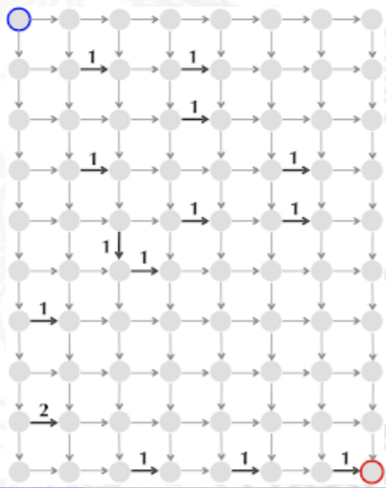
This map is honestly a bit confusing. Let’s turn each intersection into a dot, and we can link them with roads.
We will also label each road with the number of monuments in each. For example, a map could look like this.

Slide 13
I remember this type of diagram from robot 101! It’s called a Directed acyclic graph (As each arrow has a direction, and there are no circles, DAG). Each intersection is a node, and each street is an edge with a weight.
Our starting point is the source, and the arrival is the sink.
I think we have a computational problem in our hands. . .
The Manhattan Tourist Problem
Definition: Find a path visiting most attractions (namely longest path) in a rectangular city (a DAG).
Input: A weighted n × m rectangular grid with n + 1 rows and m + 1 columns
Output: A longest path from source (0,0) to sink (m,n) in the grid.

Slide 14
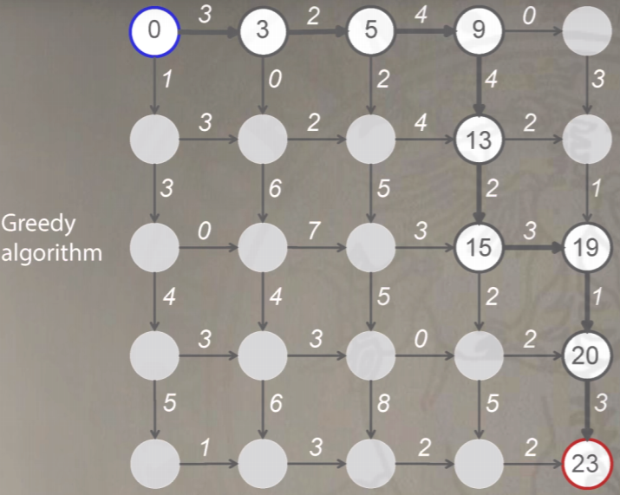
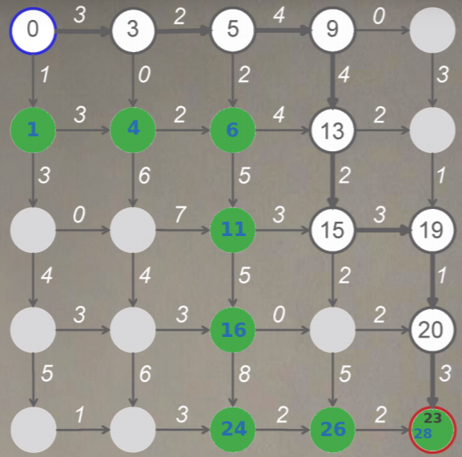
We could just consider the best choice at each intersection. In this DAG, if I start from the blue intersection, and have to reach the sink, I can follow the highlighted path by choosing always the largest weight of the paths I can follow. This will get me to the ice cream shop in no time!
Now that I got here, though, I saw that there was a better way to reach the sink. So, choosing the best option at the moment (GREEDY ALGORYTHM) may not give the best result on the long run. So, a greedy approach cannot solve the Manhattan Tourist problem.
After we couldn’t solve the Alignment problem, now we cannot even solve this one! Oh well, time to get some ice cream.

Slide 15
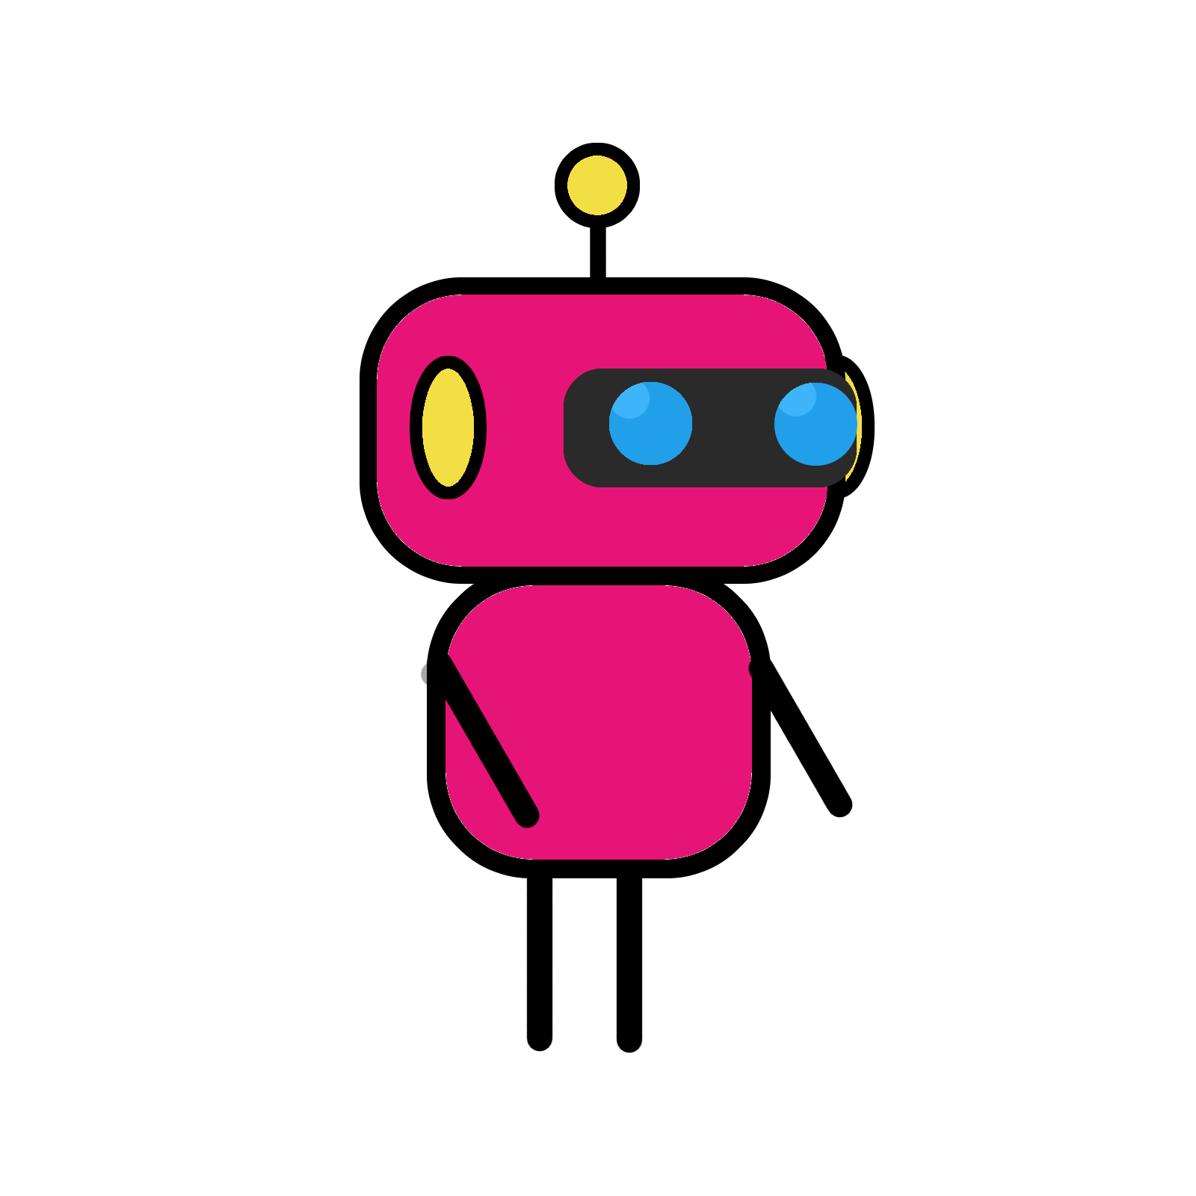
A medium chocolate ice cream, please.
That would be 1.60 bitcoins.
Could you change 2?
Erm. . .
The CHANGE problem
Or, an introduction to dynamic algorithms

Slide 16
Don’t worry, I got it. Again, this looks like a computational problem:
The change problem
Find the minimum number of coins needed to make change
Input: An integer money and an array of positive integers (coin_1, ..., coin_n)
Output: The minimum number of coins (coin_1, ..., coin_n) that changes money.
In BotLand, we have the following coins: 1, 5, 10, 20, 25 and 50.
What algorithm can return the least amount of coins? For example, to change my 40 bitcents, what is the least number of coins that the Cashier bot must use?

Slide 17
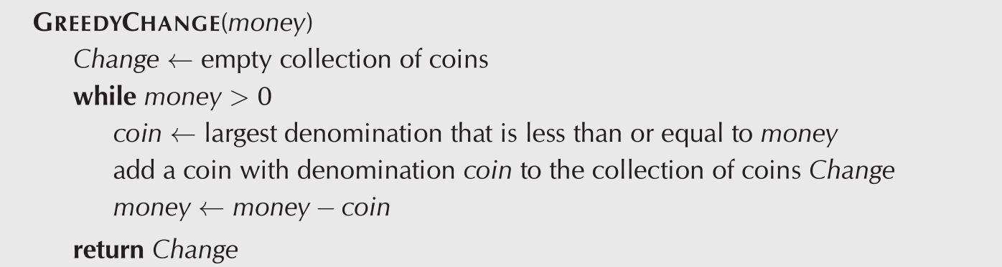
We can try a greedy approach:
Using botland coins, [1, 5, 10, 20, 25, 50], the greedy approach will first select 25, then our new money becomes (25-40) = 15, so it will select 10, and our new money becomes (15-10) = 5, and it will select 5. So, we would need 3 coins: (25, 10, 5).
However, we could have just selected two 20 coins. Again, the greedy approach will not give us the best solution (at least not in all scenarios).

Slide 18
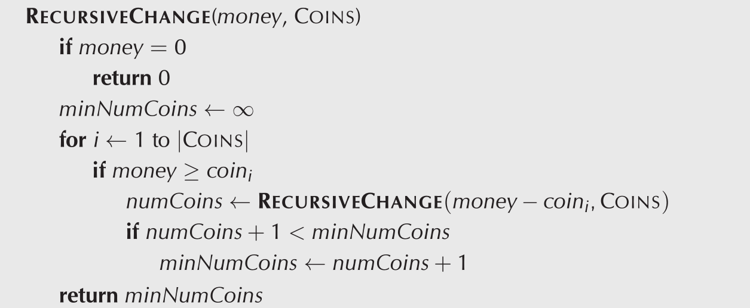
It looks like our greedy approach failed again. Perhaps we can just calculate all the possibilities, and just select the best one:
This is a recursive algorithm that will select the least amounts of coins. If it cannot, it will just compute itself one step below. To explain myself better...

Slide 19
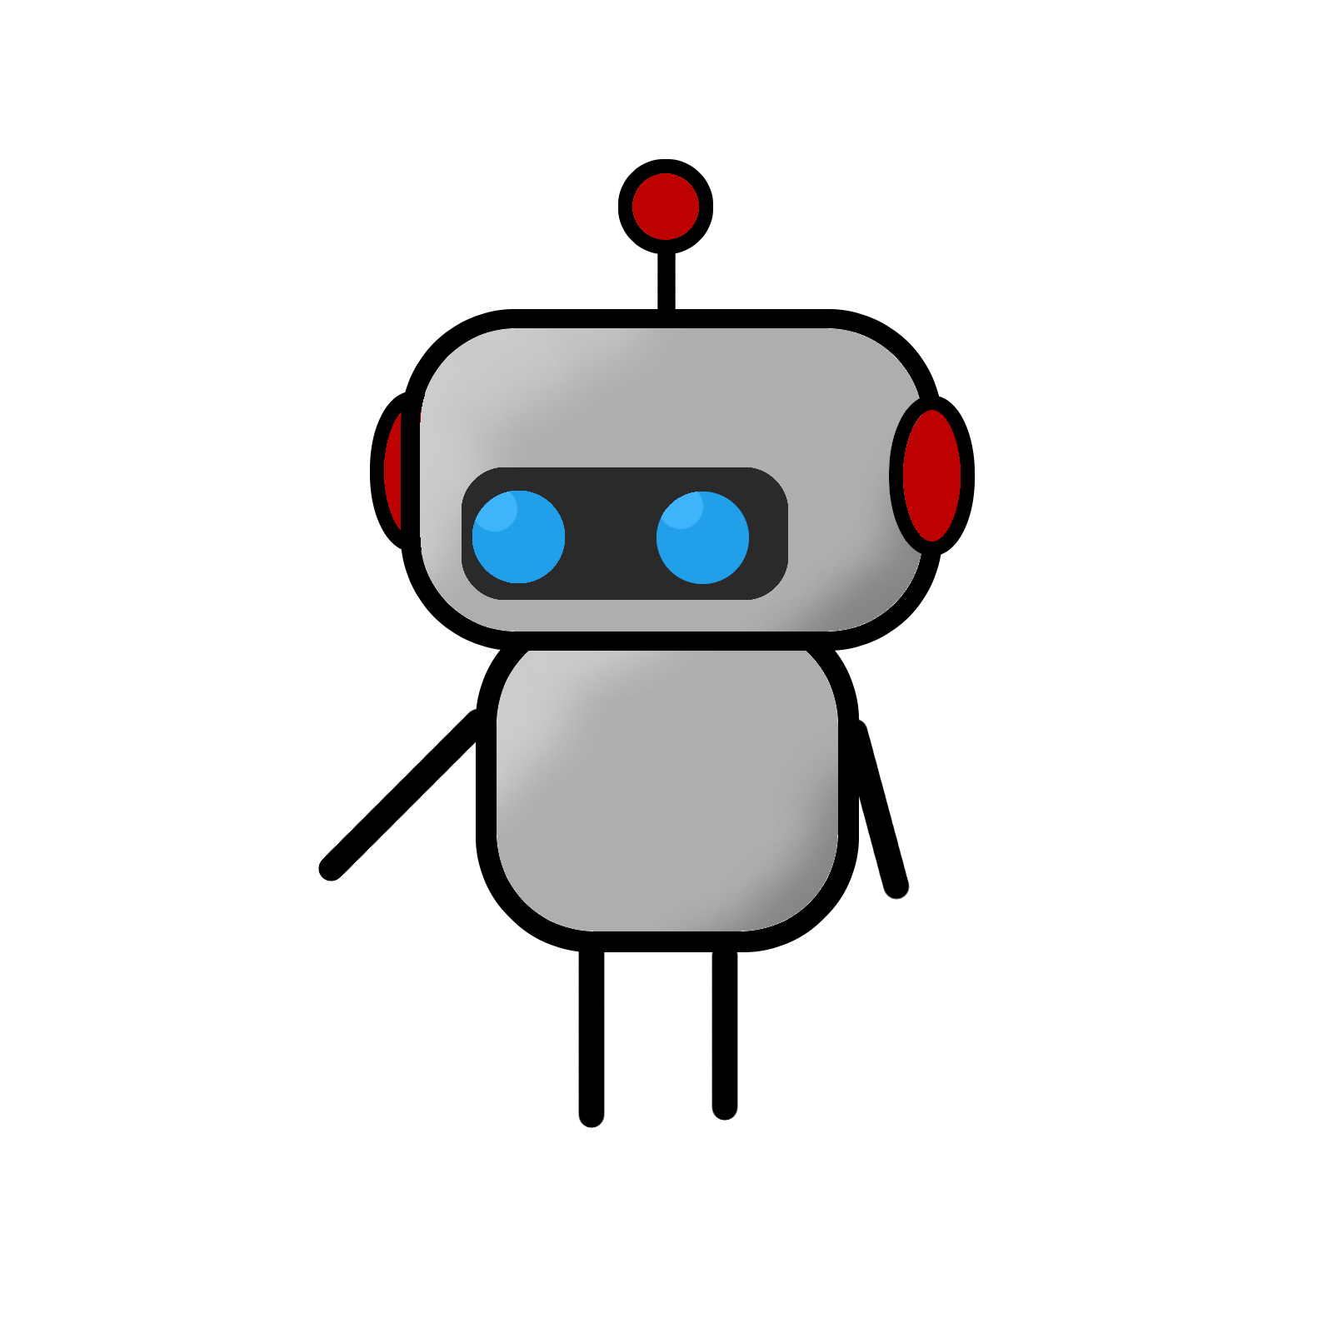
For example, computing the minimum number of coins for money = (9) with the coins [1, 5, 6] we will do:
MinNumCoins(9) = minimum(
MinNumCoins(9-6) + 1 = MinNumCoins(3) + 1
MinNumCoins(9-5) + 1 = MinNumCoins(4) + 1
MinNumCoins(9-1) + 1 = MinNumCoins(8) + 1
)
To calculate subsequent steps, like MinNumCoins(3), we will just repeat the same procedure over and over again until money=(0), then, all the algorithms above will complete one at a time, sending their result one step above. When they have all completed, the top-most will always give us the minimum amount of coins we need to use.

Slide 20
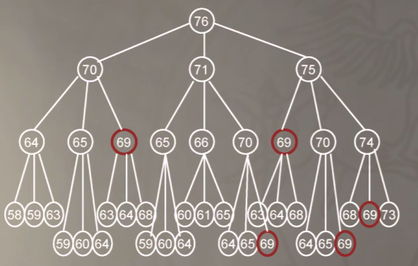
We can look at this like a tree: Each branch is a new instance of the same algorithm. They will be completed step by step, from the bottom to the top.
However, look at how many times we are calculating the exact same function in our tree. For example, this is trying to solve money=(76) with coins = [1, 5, 6]. The solution for money =(69) is computed 5 times, and the one for money = (30) is computed trillions of time! So much waste!

Slide 21
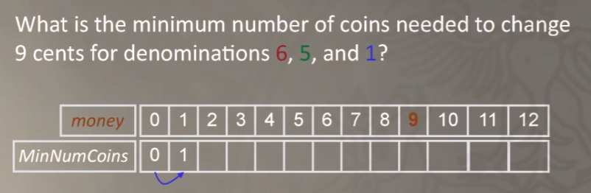
The recursive solution, then, will be way too slow for any practical application.
However, can we just simply not re-calculate several results, but only doing it once?
As an example:
If we have money=0, we will use 0 coins.
If we move on to 1, then the only possible value we can have is to use 1 [1] coin to go back to 0.

Slide 22
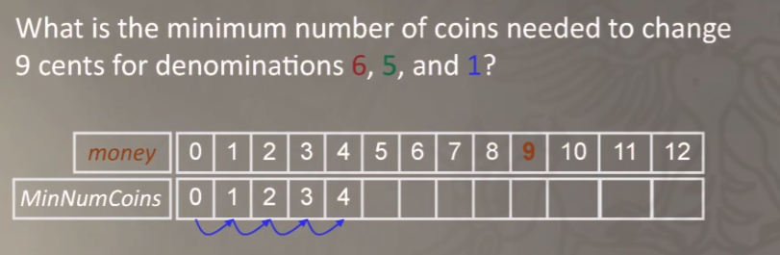
We can do the same for 2: The largest coin that fits is 1, and our new money becomes (2-1) = 1, but we already know that minNumCoins(1) is 1, so, MinNumCoins(2) = minNumCoins(1) + 1 = 1+1 = 2!
Up to four, it is the exact same thing: We calculate the new value by remembering the ones we already calculated.

Slide 23
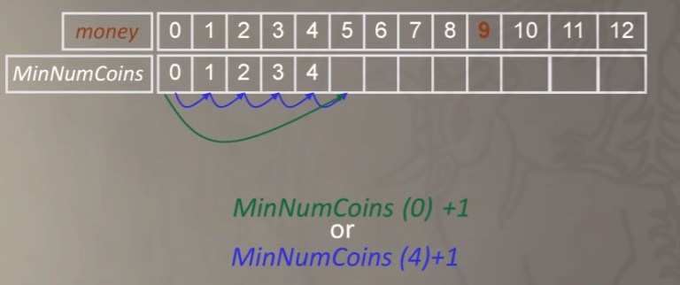
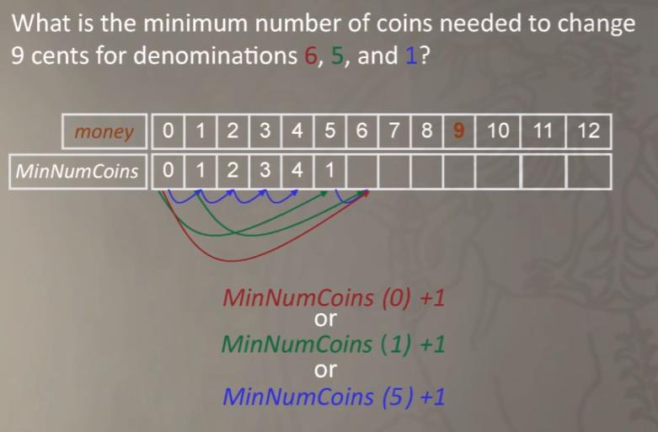
For 5, we have a choice (using [1,5,6] as our coins): we either do 5-1 or 5-5. We know what (5-1) is, it’s minNumCoins(4) +1, which is 5.
Instead, MinNumCoins(5-5) = minNumCoins(0) +1 =1, so our best option is 1! We then remember this choice, and move onto 6.
We do this again and again. The key feature of this approach is that we don’t have to calculate again and again what is the best option for every possible number, but we just remember the ones we computed earlier. When we get to 9, its answer will be the minimum number of coins needed, and we considered all possible choices, so it must be the correct value.

Slide 24
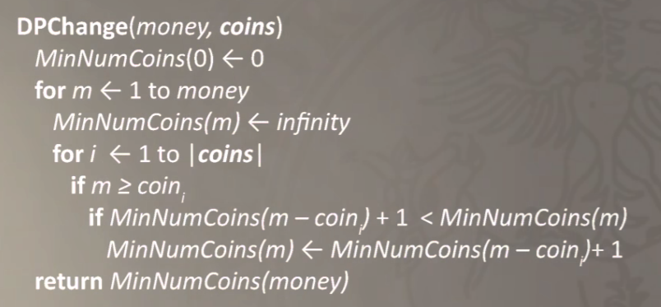
This philosophy, of starting from the bottom and calculating the choices by remembering the previous outcomes is called dynamic programming.
Here is the dynamic algorithm for the money change problem.

Slide 25

Here are your 2 [20] coins. Have a nice day!
Yay!
The change problem
Find the minimum number of coins needed to make change
Input: An integer money and an array of positive integers (coin_1, ..., coin_n)
Output: The minimum number of coins (coin_1, ..., coin_n) that changes money.
SOLVED

Slide 26
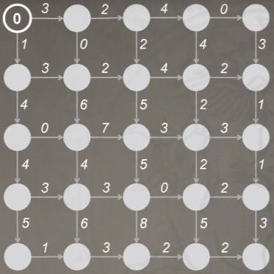
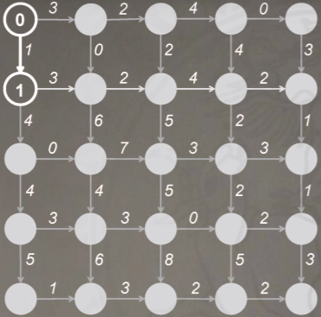
This dynamic approach got me thinking about our earlier problem.
If we begin at the source, and mark the total length of the path (the monuments we visited), we can see that to reach the node south, we only have one possible path to take, south!. If we write that down...
Once again, the only way to reach the node south of here is to use the path south. Let's write that down. As you cans see, we can move down to the bottom of the DAG this way.

Slide 27
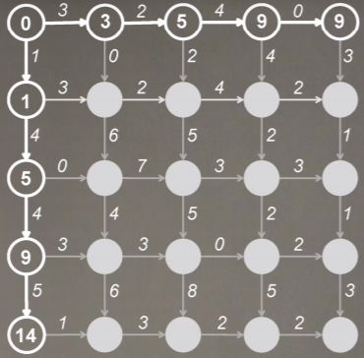
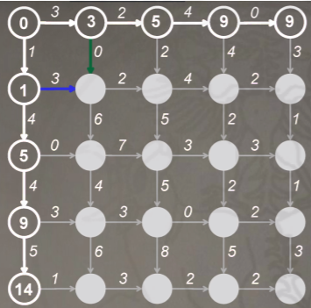
We can do the same for the path on top.
For the node in the top left angle, we can now compute the optimal path just by choosing which is the best option: 3 + 0 or 1 + 3. Since 4 > 3, the best possible path is. . .

Slide 28
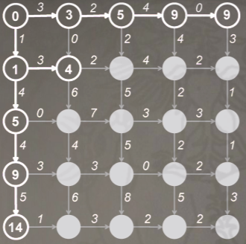
We must come in from the left!
We are now in the same case as before: We compute the new top row and left-most column by just choosing what the best option is, either to come to the node from the north, or from the west.

Slide 29
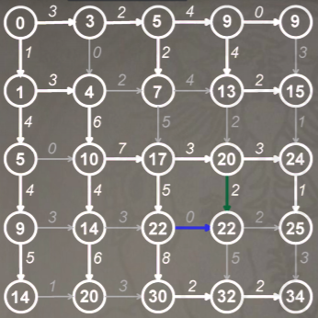
This approach also tells us when there are multiple paths that are equally long to reach a node. Look at this example here.

Slide 30
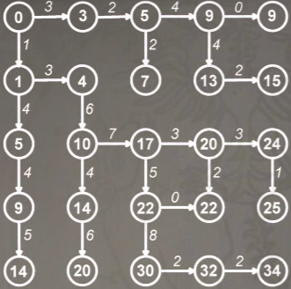
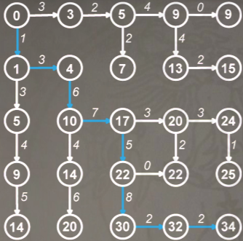
We have now obtained this graph. Since we want to go from the top-left to the bottom right, we just retrace our steps back from the sink to the source, following the pointers backwards.
We did it! We just found the longest path from the source to the sink, with no possible errors!

Slide 31
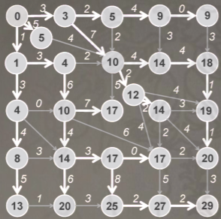
We can use the same algorithm to solve much more complicated DAGs!
The Manhattan Tourist Problem
Definition: Find a path visiting most attractions (namely longest path) in a rectangular city (a DAG).
Input: A weighted n × m rectangular grid with n + 1 rows and m + 1 columns
Output: A longest path from source (0,0) to sink (m,n) in the grid.
SOLVED

Slide 32
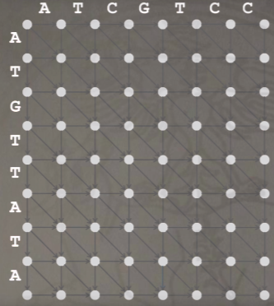
We still have to find a solution for our sequence alignment problem. Applying our previous knowledge worked for the Manhattan tourist problem, why not for the sequence alignment problem?
If we place our sequences in the top and left rows of a DAG, and codify the moves of our alignment game as the directions connecting the nodes in this way:
Moving diagonally, we are removing both symbols. We get 1 point if they match.
Moving south or east, we are adding a gap in the top and left sequences, respectively.

Slide 33
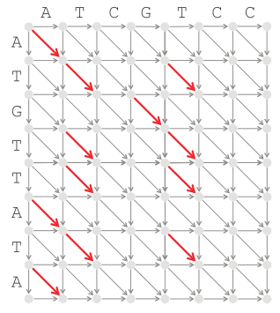
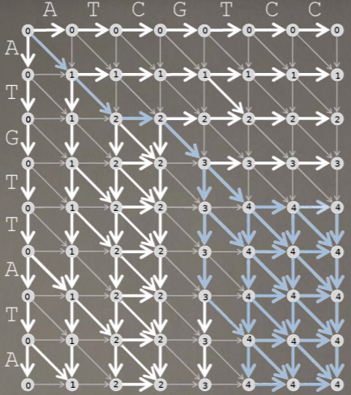
We can make this DAG, with all the red diagonals (the “remove both symbols and get 1 point”) with weight 1.
We can then apply our previous algorithm to find the longest path in this diagram...
We get this solution! We can then pick one of the (several, in this case) longest paths, and decode it as an alignment.

Slide 34
Did you notice the 4? It was the maximum possible score we could get trying to align our two sequences!

Slide 35
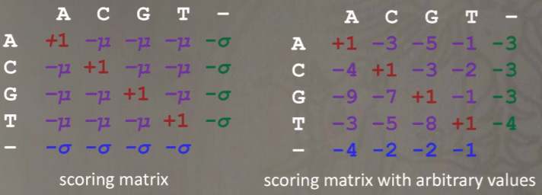
We can complicate our DAG a little (but we can solve it just as well) by changing the scoring system of the alignment game: by creating a so-called scoring matrix, we can penalize and reward differently matches, mismatches and gaps. We can also penalize more opening gaps than elongating gaps already present, so that the algorithm will open less, longer gaps in the alignments.
The scoring matrix values are simply attached to each path in our alignment DAG, the best route is found using the dynamic approach, and then the best route is followed by backtracking.

Slide 36
We can now find the best alignment (or alignments) for any two sequences, of any lengths!
Best Alignment Problem
Find the alignment that reduces the hamming distance (or some arbitrary parameter) between two strings to a minimum.
Input: two strings
Output: The best alignment of the two strings.
SOLVED

Slide 37
